Slide 1
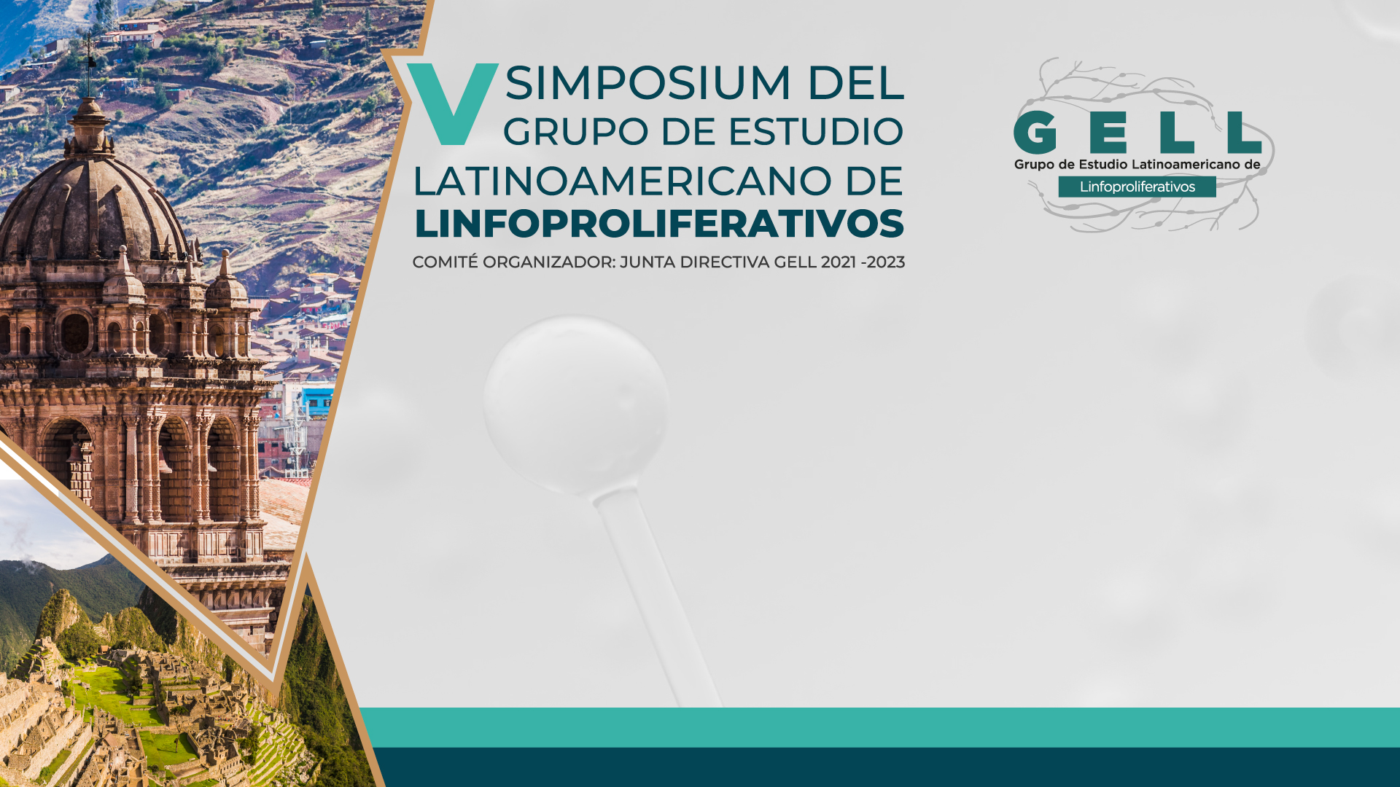

Molecular Classification of DLBCL
Mario L. Marques-Piubelli, MD
Assistant Professor
Director, Heme Malignancies Lab
Department of Translational Molecular Pathology
The University of Texas MD Anderson Cancer Center

Slide 2

Disclosure
Investigator initiated trials/Research Support
ALX Oncology
ADC Therapeutics

Slide 3
Outline
Introduction
Genetic changes in DLBCL
Molecular Classifications of DLBCL
Chapuy/Harvard
Lacey/HMRN
Schmitz/Wright-LymphGene
WHO and ICC recommendations for molecular testing
Final Remarks

Slide 4
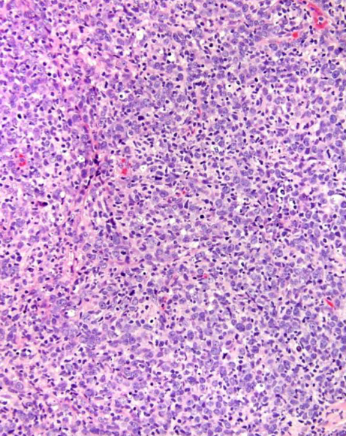
Introduction
DLBCL
30% of adult lymphoma cases
Heterogeneous
Range of many immunologic and genetic subtypes
Translation in clinical practice
COO (Cell of Origin)
IHC (Immunohistochemistry) vs GEP (Gene Expression Profiling)
Germinal Center B-cell like (GCB)
Activated B-cell like (ABC or non-GCB)
Identification of genetic markers
Implementation of effective and precise treatment
Elaboration of new therapies
DNA vs RNA
Sanger sequencing vs NGS (Next Generation Sequencing)
Notes:
DLBCL corresponds to 30% of adult lymphoma cases with more than 150k cases globally each year. As you know, it is characterized by a consistent range of cellular precursors and nuclear morphology, namely large B lymphoid cells with nuclei exceeding normal lymphocyte size, but spans many immunologic and genetic subtypes without much further classification. Immunohistochemistry in combination with various algorithms (which can differ from lab to lab) have allowed for basic classification of DLBCL into two groups, activated B-cell like type (ABC) and germinal center B-cell like type (GCB) which has provided prognostic insight into disease course without yielding much into targeted therapies for these distinct subtypes. In addition, this stratification system is largely a phenotypic description of DLBCL as opposed to a genetic description, so treatment responses are not fully explained by these subtypes. Clinically relevant stratification of DLBCL is largely non-existent and a classification such as a combination of CD10, BCL6, and IRF4/MUM1 expression, so-called “Hans classifier” was proposed to be useful in predicting long or short term survival.
Identification of genetic markers that alter disease course is essential not only for implementation of effective treatment, but also to indicate which patients may require less potent treatment or less invasive surveillance in looking for relapse. New therapies derived from NGS provided data are aimed at disrupting signaling pathways or modulating immune response, however the impact of these therapies can only be fully realized when we are able to categorize DLBCL into subtypes based on internal disease mechanism, as opposed to outward morphology or presence of basic cell markers. These internal mechanisms, and sorting the influential from the irrelevant, are the basis for future treatment modalities and the cessation of indiscriminate therapy based on patient response. In this presentation we will begin by exploring the genetic alterations in DLBCL followed by the various diagnostic criteria for subtyping of DLBCL on a molecular level, that determine disease progression and outcome. Targeted therapies aimed at these pathways will be investigated, and lastly the clinical implications and research still needed will be discussed.
And how we can molecularly analyze these samples?
Sanger sequencing
One amplicon at a time
One or more amplicon/exon
High cost/gene
Sample limitations
NGS
Many genes in one tube
Expensive, but dropping price

Slide 5
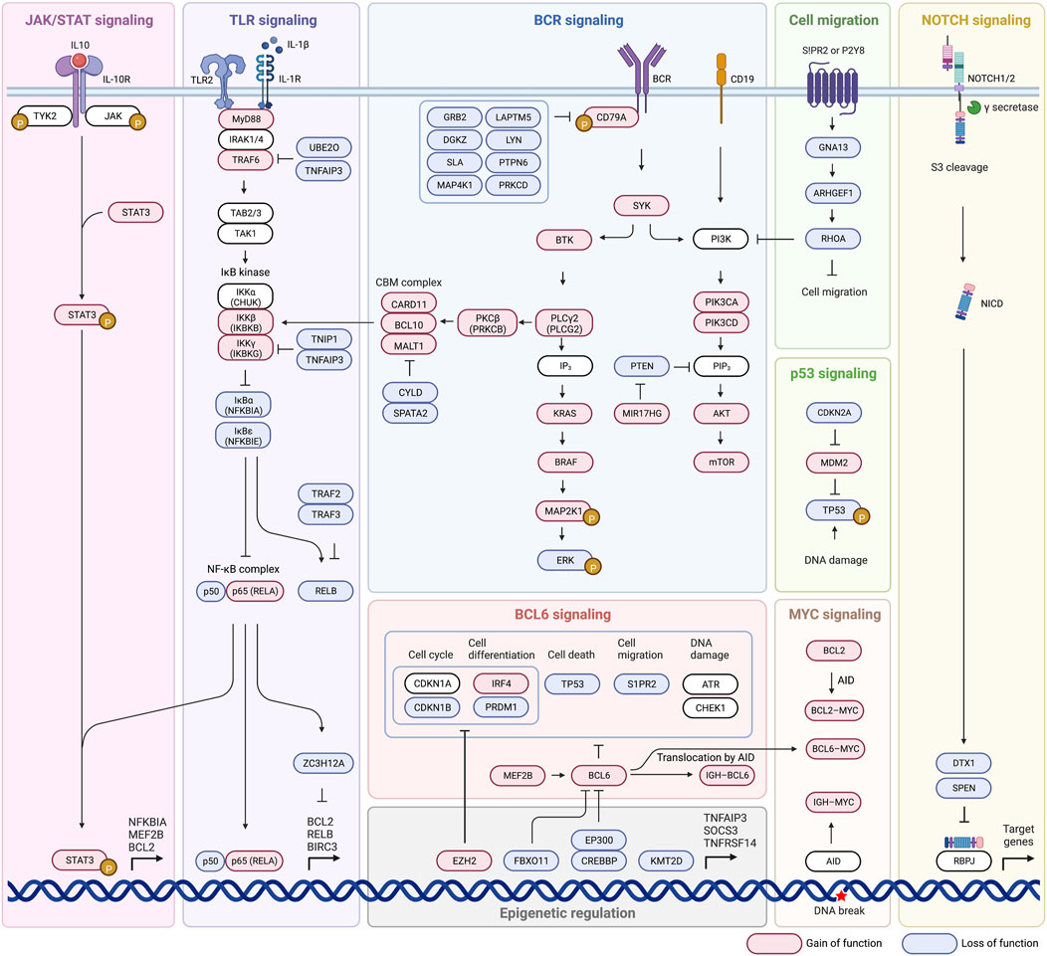
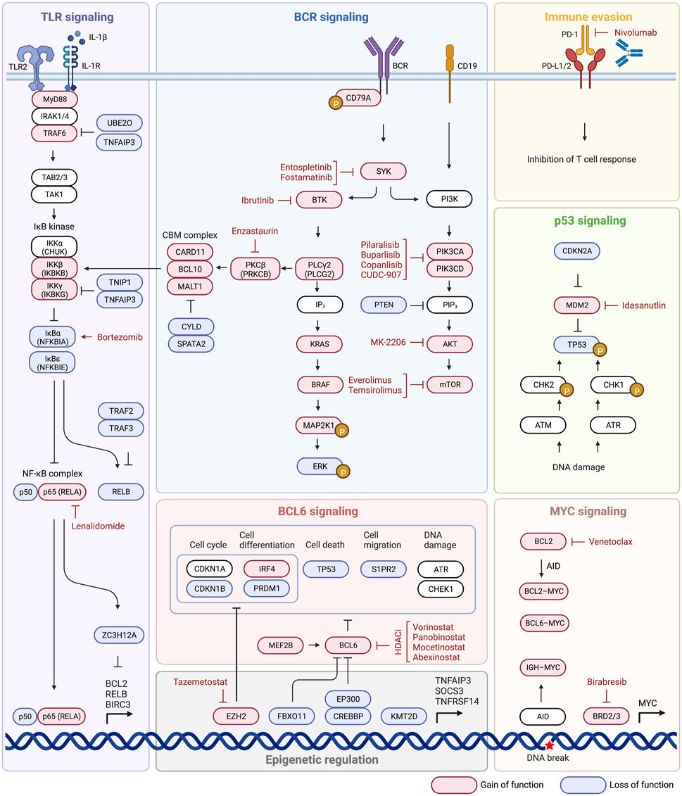
Genetic Changes
Major mutated pathways
BCR signaling (B-Cell Receptor)
BCR dependent NF-κB activation
TLR signaling (Toll-like receptor)
PI3K-AKT-mTOR signaling
NF-κB signaling
BCL2 anti-apoptotic family
Immune Evasion
NOTCH Signaling
Shimkus et al, Front Mol Biosci, 2023
Notes:
Understanding which genetic anomalies tend to occur together and the associated prognosis is an essential primary step in establishing a new categorization system for DLBCL, but is far from the end product. To develop effective treatments we must thoroughly understand the pathways that have undergone alteration, and establish whether or not they are even influential in overall disease progression. Equally important is establishing where in a specific pathway the disruption occurs, because mutations downstream of drug targets may render the drug useless, even if it acts on the appropriate pathway. By taking a closer look at which pathways tend to undergo alteration and where alterations tend to take place, we will establish not only the extreme complexity of DLBCL, but can begin to identify potential drug targets for later discussion of therapeutic indications.
BCR and TLR signaling: involved in regulation of B cell survival, development, and differentiation, and can be chronic active (non-GCB) or tonic (GCB) in DLBCL, and both overexpression and overactivation are implicated in lymphomagenesis. Mutations that lead gain of function in this cascade may lead a hyperactivation in any part of this pathway. In contrast, loss of function mutations are more common in TLR activation. The most common mutation affecting BCR and TLR signaling is MYD88, which directly affects TLR signaling and indirectly influences BCR signaling because MYD88, TLR9, and BCR form a multiprotein supercomplex which leads to promotion of downstream NF-κB and mTOR activation.
BCR-dependent NF-κB activation: Normally, BCR stimulation caused by antigen binding activates BTK signaling through SYK activation, which phosphorylates CARD11 and recruits BCL10 and MALT1 to form the CBM complex (CBM complex) that inactivates negative regulator CYLD/SPATA2 complex and inactivates RELB. Mutations that cause overactivation of BCR signaling such as activating mutations of CD79A/CD79B or SYK which overstimulate BTK/PLCG2 causing activation of PRKCB and the CBM complex lead to an overactive NF-κB pathway
Toll-like receptor (TLR) signaling: Toll-like receptor 2 (TLR2) signaling in its standard state is mediated by MYD88. Mutation of MYD88 promotes assembly of a complex composed of IRAK1 and IRAK4, which can then accomplish downstream NF-κB and JAK/STAT signaling through the IκB kinase pathway.
PI3K-AKT-mTOR signaling: PI3K can indirectly activate NF-κB pathway and was genetically altered in 34.3% of cases of DLBCL, and is also able to directly activate mTOR mechanisms. Its activation promotes cell proliferation and metabolism which is important to tumor initiation and progression. The activation can be through BCR signaling or its co-receptor (CD19)
NF-κB signaling: NF-κB signaling may also be stimulated through activation of the IKBKG/IKBKB complex, which is only partially dependent on the BCR pathway and may be activated through various means, such as MYD88
Anti-apoptotic BCL2 family and BCL6 family: Translocations such as this move BCL2 near genes that cause over activation, or constitutive activation of BCL2 and promote survival, while BCL6 may be implicated in different cell functions, such as cell cycle, cell death, migration and DNA damage.
Other pathways also involved include: NOTCH signaling, p53 signaling, MYC signaling, and evasion of immune surveillance

Slide 6
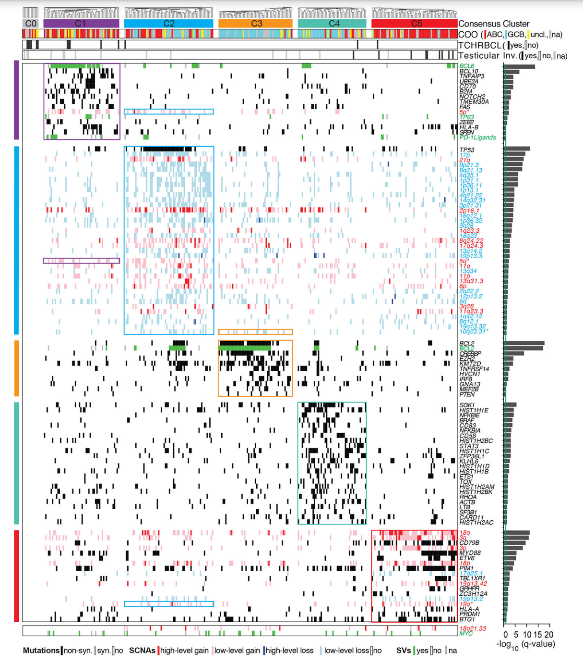
Molecular Classifications
Chapuy/Harvard
C1
Non-GCB
SV BCL6 and NOTCH2
C2
GCB and Non-GCB
TP53
C3
GCB
BCL2 and Chromatin modifiers
C4
GCB
Immune evasion: CD83, CD58, CD70
C5
Non-GCB
Mutations in CD79B and MYD88 and 18q gain
C0
No genetic drivers
Chapuy et al, Nat Med, 2018
Notes:
In this study conducted at Harvard, they carried out a comprehensive genetic analysis of 304 primary DLBCLs that identifies low-frequency alterations, captured recurrent mutations, somatic copy number alterations (SCNAs) and structural variants (SVs), and defined coordinate signatures in patients with available outcome data. In the study, around 55% of the cases lacked normal matched-control and because of this they developed a new computational method to filter the germline variants and possible artifacts from the cases with tumor-only samples. They integrated these genetic drivers using consensus clustering and identified five robust DLBCL subsets or clusters:
C1: most of C1 clusters had structural variants of BCL6 in combination with mutations in NOTCH2 pathway, most commonly found in marginal zone lymphoma, although the cases had no histologic features of MZL. Also, most of them were non-GCB
C2: biallelic mutations of TP53 and 17p copy loss; also had CDKN2A and RB1 loss; included both GCB and non-GCB
C3: characteristically this group had mutations in BCL2 and also in chromatin modifiers, such as KMT2D, CREBBP, and EZH2. Most were GCB These same genetic findings are found in FL and DHL.
C4: most of them were GCB and had constant mutations in multiple immune evasion genes, such as CD83, CD58, and CD70
C5: almost 100% of the cases were non GCB and had mutations in CD79B and MYD88 in around 50% of the cases and also had a uniform gain of 18q and BCL2. Also, most of the cases were extranodal, mostly primary of CNS or testicle, now known ad immune-priviledge sites
C0: in 12 cases no genetic drivers were identified and included several TCHRLCL. This was most likely due the rich inflammatory background.
Patients with C0, C1 and C4 DLBCLs had more favorable outcomes, whereas those with C3 and C5 tumors had less favorable outcomes
These different genetic features and subsets provided new insights into DLBCL pathogenesis and were fundamental for the subsequently classifications. The coordinate genetic signatures also predict outcome independent of the clinical International Prognostic Index and suggest new combination treatment strategies.

Slide 7
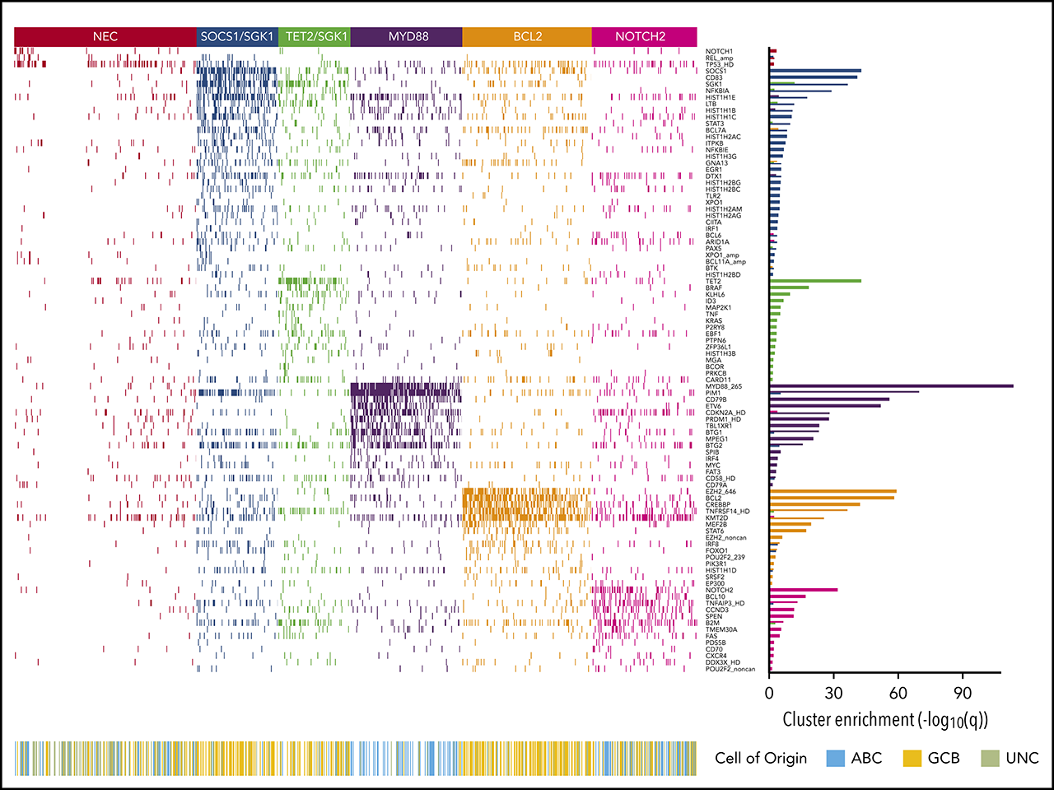
Molecular Classifications
Lacey/HMRN
MYD88 (n= 152)
MYD88, PIM1, CD79B, ETV6
BCL2 (n= 176)
EZH2, BCL2, CREBBP, TNFRSF14, KMT2D, MEF2B
SOCS1/SGK1 (n= 111)
SOCS1, CD83, SGK1, NFKBIA, HIST1H1E, STAT3
TET2/SGK1 (n= 98)
TET2, SGK1, KLHL6, BRAF, MAP2K1, KRAS
NOTCH2 (n= 143)
NOTCH2, BCL10, TNFAIP3, CCND3, SPEN, FAS, CD70
NEC (n= 248, 27%)
No drivers
Lacy et al, Blood, 2020
Notes:
In this study conducted by the UK group in 2020, they carried out a profiling of genetic alterations occurring in tumor samples from selected diffuse large B-cell lymphoma (DLBCL) patients. Using clustering techniques applied to targeted sequencing data derived from a large unselected population-based patient cohort with full clinical follow-up (n = 928), they investigated whether molecular subtypes can be robustly identified using methods potentially applicable in routine clinical practice. DNA extracted from DLBCL tumors diagnosed in patients residing in a catchment population of ∼4 million (14 centers) were sequenced with a targeted 293-gene hematological-malignancy panel. Bernoulli mixture-model clustering was applied and the resulting subtypes analyzed in relation to their clinical characteristics and outcomes. Five molecular subtypes were resolved, termed MYD88, BCL2, SOCS1/SGK1, TET2/SGK1, and NOTCH2, along with an unclassified group:
MYD88 group: The MYD88 cluster (n = 152) was dominated by mutation of MYD88 (L265P), PIM1, CD79B, and ETV6 and frequent loss of CDKN2A; the available gene expression data showed that most belonged to the ABC subtype, with enrichment for signatures associated with ABC-DLBCL, IRF4, and MYC
BCL2 cluster: The BCL2 cluster (n = 176) showed frequent mutation of EZH2, BCL2, CREBBP, TNFRSF14, KMT2D, and MEF2B. The majority of cases for whom FISH was available had a t(14:18) BCL2 translocation, and mutation of BCL2 was strongly correlated with this translocation (P < .0001). Most cases of transformed follicular lymphoma fell within this cluster, robustly mapping to the previously described in C3 clusters
SOCS1/SGK1: The SOCS1/SGK1 group (n = 111) was characterized by mutations, including SOCS1, CD83, SGK1, NFKBIA, HIST1H1E, and STAT3. Several of these genes, including SOCS1, were known targets of aberrant somatic hypermutation. This cluster seems to represent a subdivision of the recently described C4 cluster. SOCS1 mutation is a finding shared with primary mediastinal B-cell lymphoma (PMBCL)
TET2/SGK1: The TET2/SGK1 (n = 98) cluster was characterized by mutations including TET2, SGK1, KLHL6, ZFP36L1, BRAF, MAP2K1, and KRAS. The mutation of multiple components of the ERK pathway was associated with enrichment of gene expression signatures of RAS and ERK. Predominantly GCB in origin, these cases seem to represent a second subdivision of the recently described C4 cluster.
NOTCH2: A final NOTCH2 cluster (n = 143) was characterized by mutations including NOTCH2, BCL10, TNFAIP3, CCND3, SPEN, TMEM30A FAS, and CD70. Gene expression showed that this cluster comprised a mixture of ABC, GCB, and unclassified DLBCL. The mutational similarities suggest biological similarity to marginal zone lymphoma. This group corresponds closely to the previously described BN2 or C1 subtypes.

Slide 8
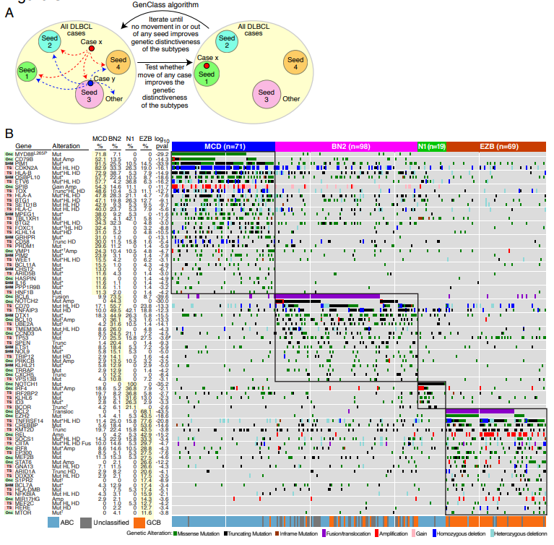
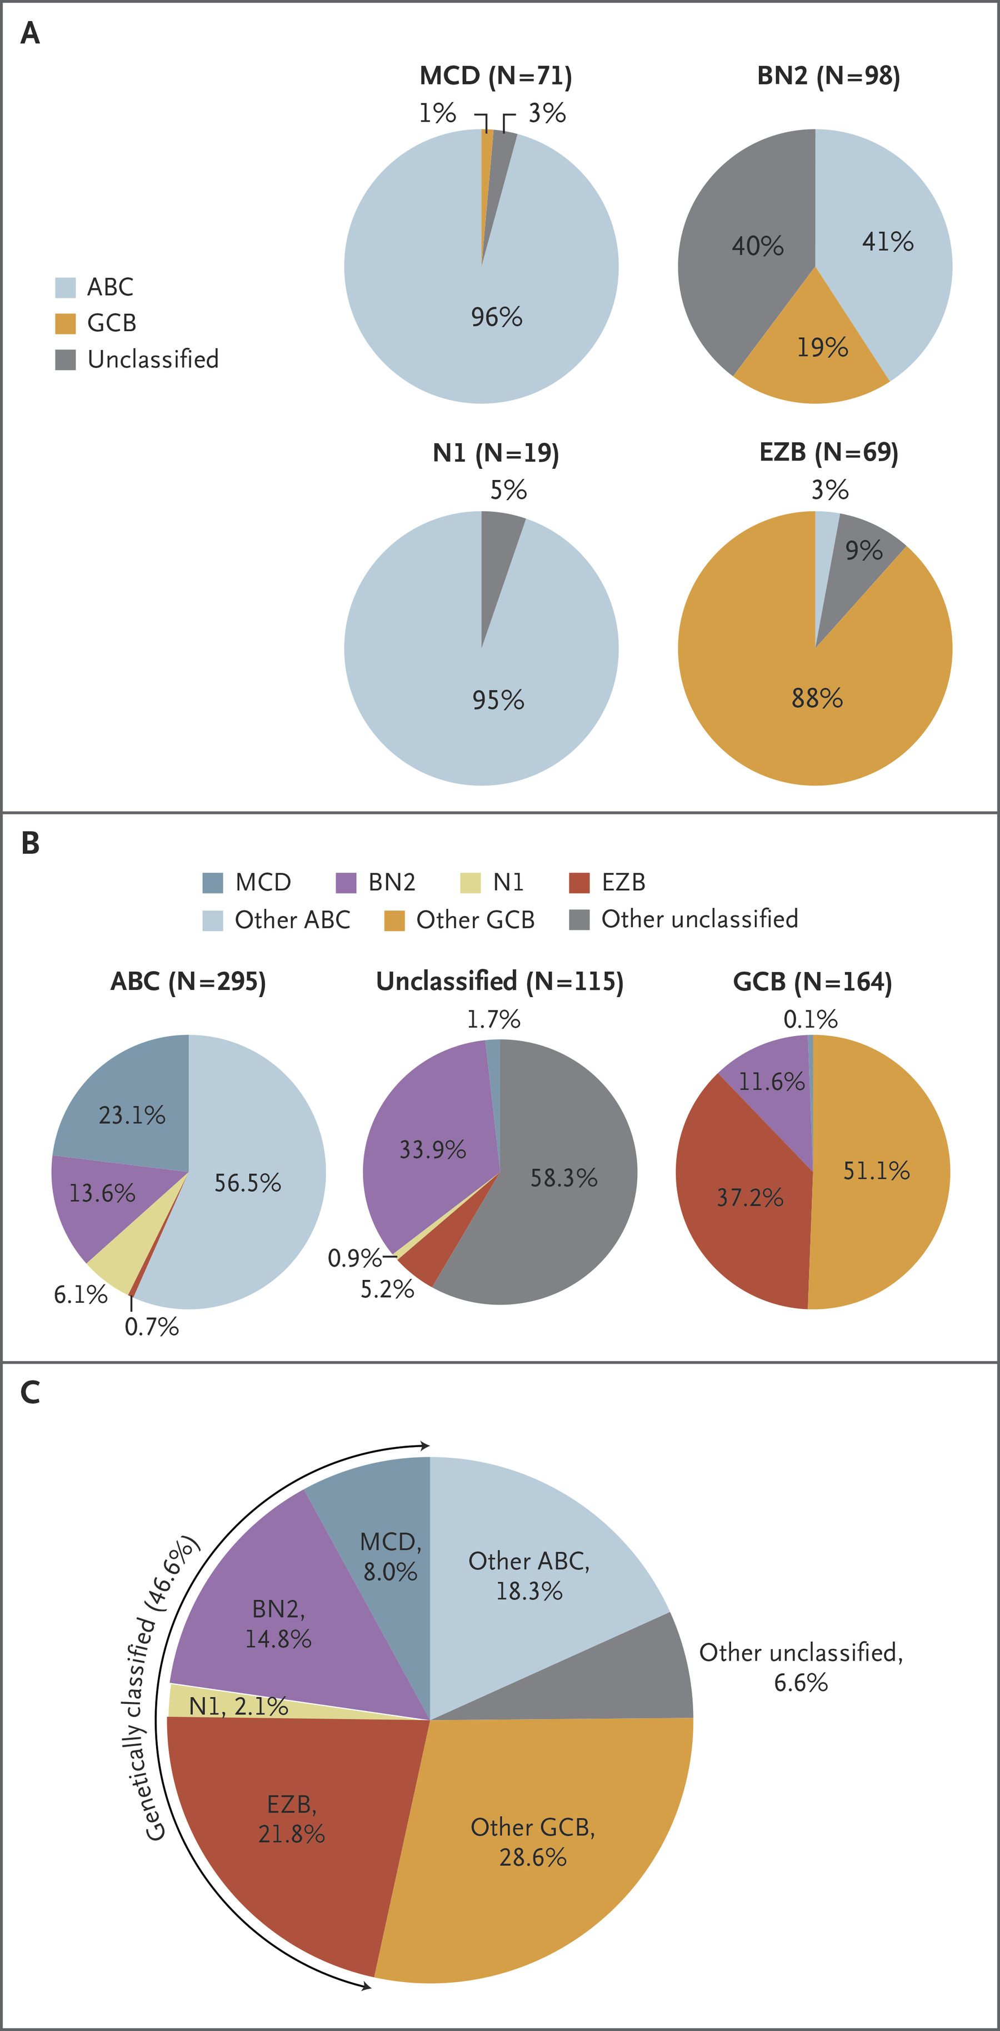
Molecular Classifications
Schmitz
Schmitz et al, N Engl J Med, 2018
Notes:
In the first, they studied 574 DLBCL biopsy samples using exome and transcriptome sequencing, array-based DNA copy-number analysis, and targeted amplicon resequencing of 372 genes to identify genes with recurrent aberrations. We developed and implemented an algorithm to discover genetic subtypes based on the co-occurrence of genetic alterations. They identified four prominent genetic subtypes in DLBCL, termed MCD (based on the co-occurrence of MYD88^{L265P} and CD79B mutations and mostly ABC), BN2 (based on BCL6 fusions and NOTCH2 mutations, with same proportions of GCB and non-GCB), N1 (based on NOTCH1 mutations, mostly ABC), and EZB (based on EZH2 mutations and BCL2 translocations and mostly GCB).
Genetic aberrations in multiple genes distinguished each genetic subtype from other DLBCLs. These subtypes differed phenotypically, as judged by differences in gene-expression signatures and responses to immunochemotherapy, with favorable survival in the BN2 and EZB subtypes and inferior outcomes in the MCD and N1 subtypes. Analysis of genetic pathways suggested that MCD and BN2 DLBCLs rely on “chronic active” B-cell receptor signaling that is amenable to therapeutic inhibition.

Slide 9
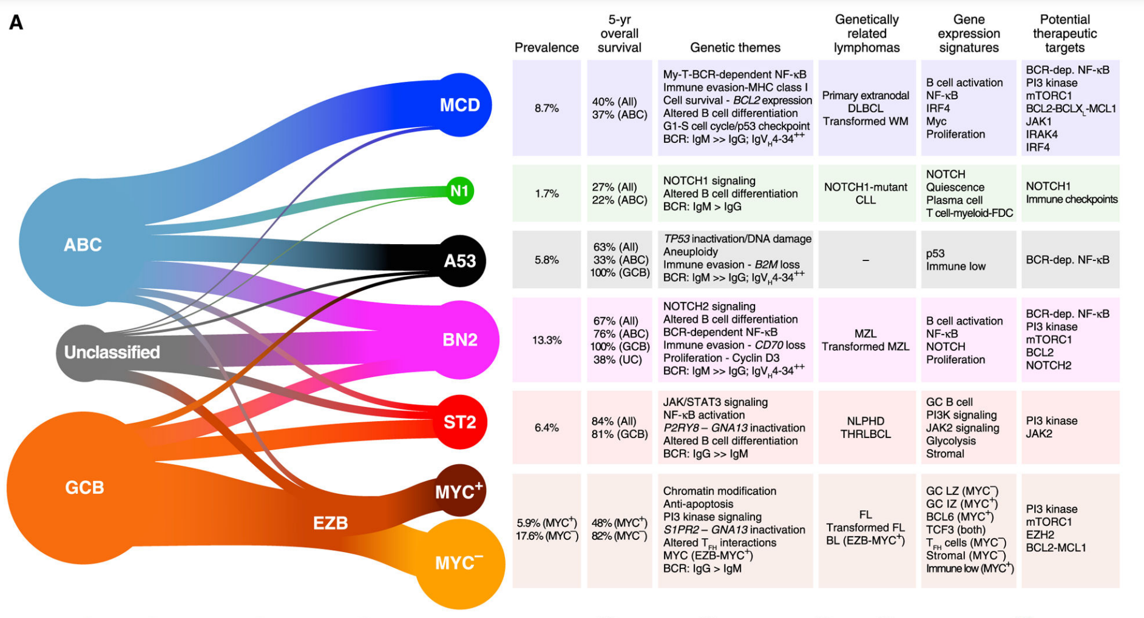
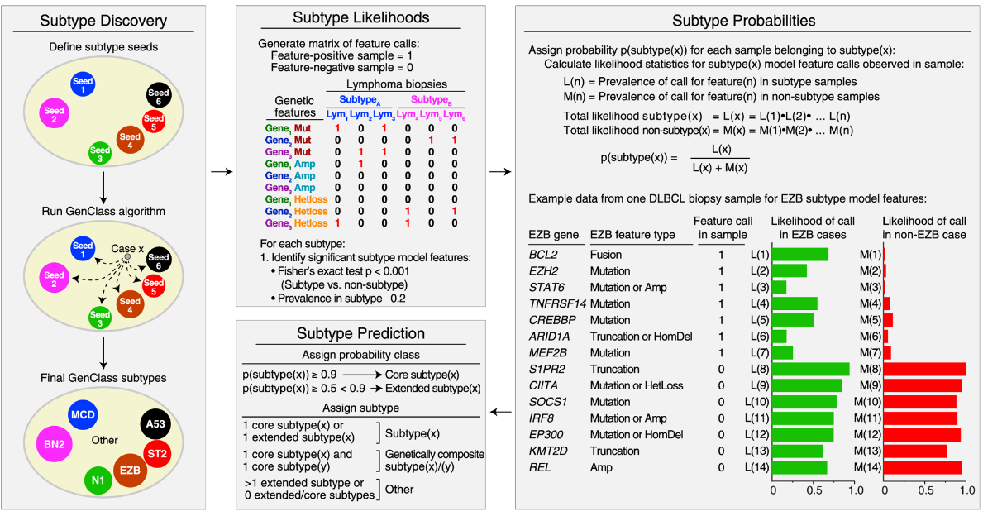
Molecular Classifications
Wright-LymphGene
Wright et al, Cancer Cell, 2020
Notes:
In a very similar way and more broad, wright and colleagues studied the molecular classification of two cohorts with more than 3000 patients each and divided in the classification that we consider as more recent. This classification system usied an algorithm referred to as “LymphGen” and intended on developing a more clinically useful stratification system based partially on work done by Schmitz et al. and Chapuy et al. This algorithm again recognizes genetic “constellations” rather than individual abnormalities and divides patients into 7 groups based on the prevalence of defined features. These groups are “MCD” characterized by BCR-dependent NF-κB immune evasion, “N1” characterized by NOTCH1 signaling and altered B cell differentiation, “A53” characterized by TP53 inactivation and aneuploidy, “BN2” characterized by NOTCH2 signaling with BCR dependent NF-κB immune evasion and a loss of CD70, “ST2” characterized by JAK/STAT3 signaling with NF-κB activation, and EZB which was further subdivided as being MYC+/− (“EZB-MYC+” and “EZB-MYC–“) and had chromatin modification conferring anti-apoptosis as well as PI3 kinase signaling and S1PR2-GNA13 inactivation. The LymphGen algorithm, using these criteria among other genetic markers, used genetic information gathered from malignant cells to then score the cells on the presence of these various mutations and assign them to the appropriate group based on assigned confidence intervals. The benefit to this algorithm was the ability to not only define subtype based on presence of these traits, but also to identify cells that had a probability of being part of a core, extended or genetically composite group where probability of belonging to a subtype was >90%, 50%–90%, or if the cell was a core member of more than one subtype, respectively. Using the algorithm, 63.1% of the cohort was able to be classified, greater than the 46.6% classified by Schmitz et al.

Slide 10
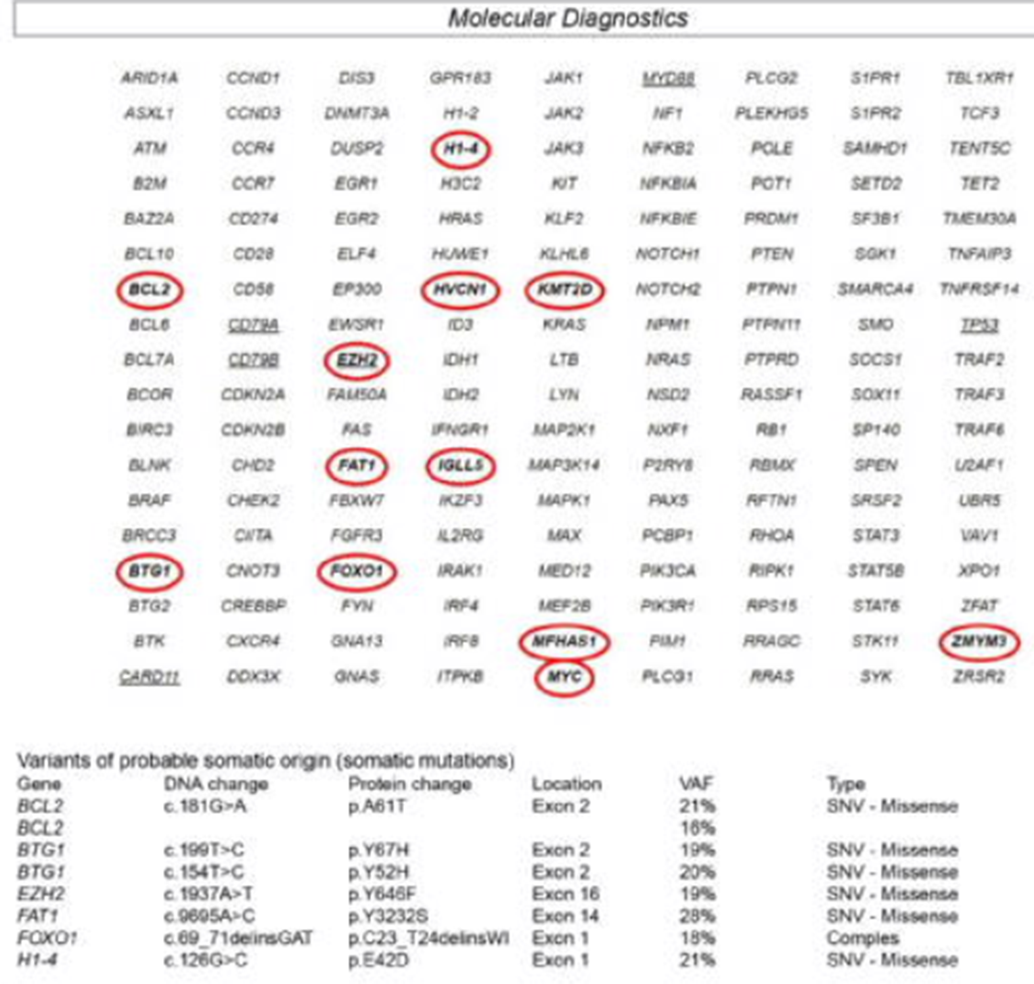
Molecular Classifications
MDACC experience
WES | EndLymphoma
EZB | EZB
EZB | EZB
EZB | EZB
EZB | EZB
EZB | EZB
EZB | EZB
EZB | EZB
EZB | EZB
EZB | EZB
EZB | Other
A53 | Other
Other | Other
Other | Other
Other | Other
Other | Other
Other | Other
Other | Other
Other | Other
Other | Other
Demographic and mutational data, n= 53 (%)
Sex
Male | 32 (60%)
Female | 21 (50%)
Age, median (range), years | 67 years (21 – 95 years)
Race
White | 46 (87%)
Black | 2 (3.7%)
Indigenous | 1 (1.8%)
Others | 4 (7.5%)
Molecular Status
Number of mutations | 811
Number of Genes | 162
EZB (MYC+/MYC-) | 15 (28%)
ST2 | 5 (9%)
BN2 | 3 (6%)
MCD | 2 (3.7%)
EZB/BN2 | 1 (1.8%)
NEC | 27 (51.1%)
Okechukwu VN, Marques-Piubelli ML & Vega F et al, USCAP Annual Meeting, 2023
Notes:
In this work previously presented at USCAP annual meeting we evaluated whether the current MDACC EndLymphoma mutational assay associated with FISH could be used to obtain the LymphGen genetic subtype of DLBCL. Our panel is a hybrid capture-based platform comprised of 162 genes that combines hot spots and whole exon coverage. ELM and FISH results (MYC, BCL2, and BCL6) from 53 DLBCL patients were collected. These data were used to obtain the molecular subtype of DLBCL as determined by the NCI LymphGen classifier. Whole exome sequencing (WES) from an independent set of 19 cases was used as a gold standard to compare the molecular subtype obtained using the ELM assay plus FISH. Most of patients were male, with a median age of 67 years and a total of 811 mutations in 162 genes were observed (of that, 20% involving TP53). As you may see, in around 30% the cases were classified as EZB (about 50% MYC+ and 50% MYC-), about 10% were ST2, 6% BN2, 4% MCD, 1 case was EZB/BN2 and 51% of the cases werent classified. The median turn-around-time for the ELM assay was 12 days (range, 6-24) and for FISH 4 days (range, 1-14) and there was a substantial agreement (Fleiss kappa=0.8) between the ELM/FISH and WES assays to determine the LympGen subtype. The median OS was 120 months (range, 21-218). Patient age and treatment response significantly correlated with patient OS, but not the molecular status, due the quantity of variables. All 4 EZB/MYC+ patients with adequate clinical follow-up were poor responders whereas 50% of patients in the EZB/MYC- group had a good response.

Slide 11
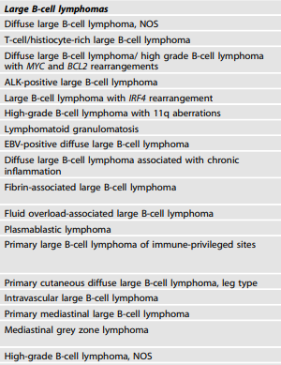
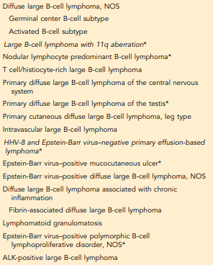
WHO-HAEM5 vs ICC
WHO-HAEM5
ICC
COO by IHC
FISH testing
MYC
BCL2/BCL6
IRF4
Molecular testing and molecular subgroups
Clonality
Clinical trials
Campo et al, Blood, 2022
Alaggio et al, Leukemia, 2022
Notes:
WHO: First of all, WHO still recommends report COO according IHC. It is important to be aware of the coverage of the different MYC break-apart probes used for analysis of MYC gene rearrangement, since not all probes cover the whole spectrum of potential breakpoints at the MYC locus, especially cryptic fusions, insertions into MYC and insertions of MYC into other loci might escape break-apart probe design and require fusion probe assays. Likewise, rare MYC, as well as BCL2, rearrangements may be cytogenetically cryptic and thus fail to be detected by conventional FISH.
Cases displaying an isolated MYC rearrangement or dual rearrangements of MYC and BCL6 do fall within the spectrum of DLBCL, NOS; if a MYC or a simultaneous MYC and BCL6 rearrangement is detected, it should be reported (DLBCL, NOS with MYC or MYC and BCL6 rearrangement). DLBCL, NOS in younger patients, localized to the head and neck region with strong and uniform MUM1 expression suggests large B-cell lymphoma with IRF4 rearrangement; IRF4 rearrangement should be evaluated in such cases, and if present, excludes DLBCL, NOS. In occasional cases, clonality analysis and/or genetic profiling may be helpful, if clinically relevant. In particular, the presence of individual mutations, such as MYD88, might aid in reaching a diagnosis, especially in small biopsies from extra-nodal sites. Gene expression profiling (GEP) is the gold standard for cell of origin (COO) determination. Since detailed mutation spectra as obtained by targeted panel and/or whole exome/genome sequencing currently have very limited consequences for treatment decisions outside clinical trials, such analyses have little role at present in routine practice. However, this situation may be subject to change in the coming few years as more knowledge and diagnostic assays become available.
Mutational subgroups of DLBCL. The proposed mutational subtypes in DLBCL, NOS have a different impact on prognosis , however there is currently no consensus as to how this additional information might aid in treatment decision making. Before meaningful introduction in practice, harmonization between the different proposed molecular classifications, including technical and bioinformatic aspects and availability of assays under good laboratory practice standards are needed. Thereafter, clinical trials are required before the clinical utility of the sub-groups can be fully elucidated. The prognostic impact of non-coding mutations is yet unexplored.
ICC: In ICC it is recognized that molecular and cytogenetic profiling studies have independently identified 5 to 7 new functional genetic subgroups of DLBCL, which strongly emphasizes the validity of this concept but fails to classify all patients (Figure 2).¹³¹⁻¹³⁴ A combination of cell-of-origin and molecular subclassification may provide more precise patient stratification for developing future clinical trials.¹³⁵ Overall, cell-of-origin is retained for the present time with the expectation that transition to a molecular genetic classification will be feasible in the near future.

Slide 12
Final remarks
Chapuy, 2018 N= 304; WES Nat Med | Lacy, 2020 N=928; NGS panel Blood | Schmitz, 2018 N=574; Transc N Engl J Med | Wright, 2020 N=304/332; Lymphgen Cancer Cell | Mutations | COO | Outcomes | Related Type
C1 | NOTCH2 | BN2 |  | BCL10, NOTCH2, SPEN, CD70, BCL6 | Non-GCB, GCB, UC | Intermediate | MZL
N/A | NOTCH1 | N1 |  | NOTCH1, ID3 | ABC | Poor | CLL
C2 | N/A | A53 |  | TP53 | Non-GCB, GCB, UC | Intermediate
C3 | BCL2 | EZB |  | EZH2, BCL2, CREBBP, KMT2D | GCB | Good | FL
 | BCL2-MYC | EZB-MYC+ |  |  |  | Poor | DHL
C4 | SGK1/TET2 | ST2 |  | SGK1, TET2, KLHL6, BRAF, MAP2K1, KRAS | GCB | Good | NLPHL
 | SGK1/SOCS1 |  |  | SOCS1, SGK1, CD83, STAT3 |  |  | PMBL
C5 | MYD88 | MCD |  | MYD88, CD79B, PIM1 | Non-GCB | Poor | PLBCLIP
C0 | NEC | Other |  | N/A | Non-GCB, GCB, UC | Intermediate | N/A

Slide 13
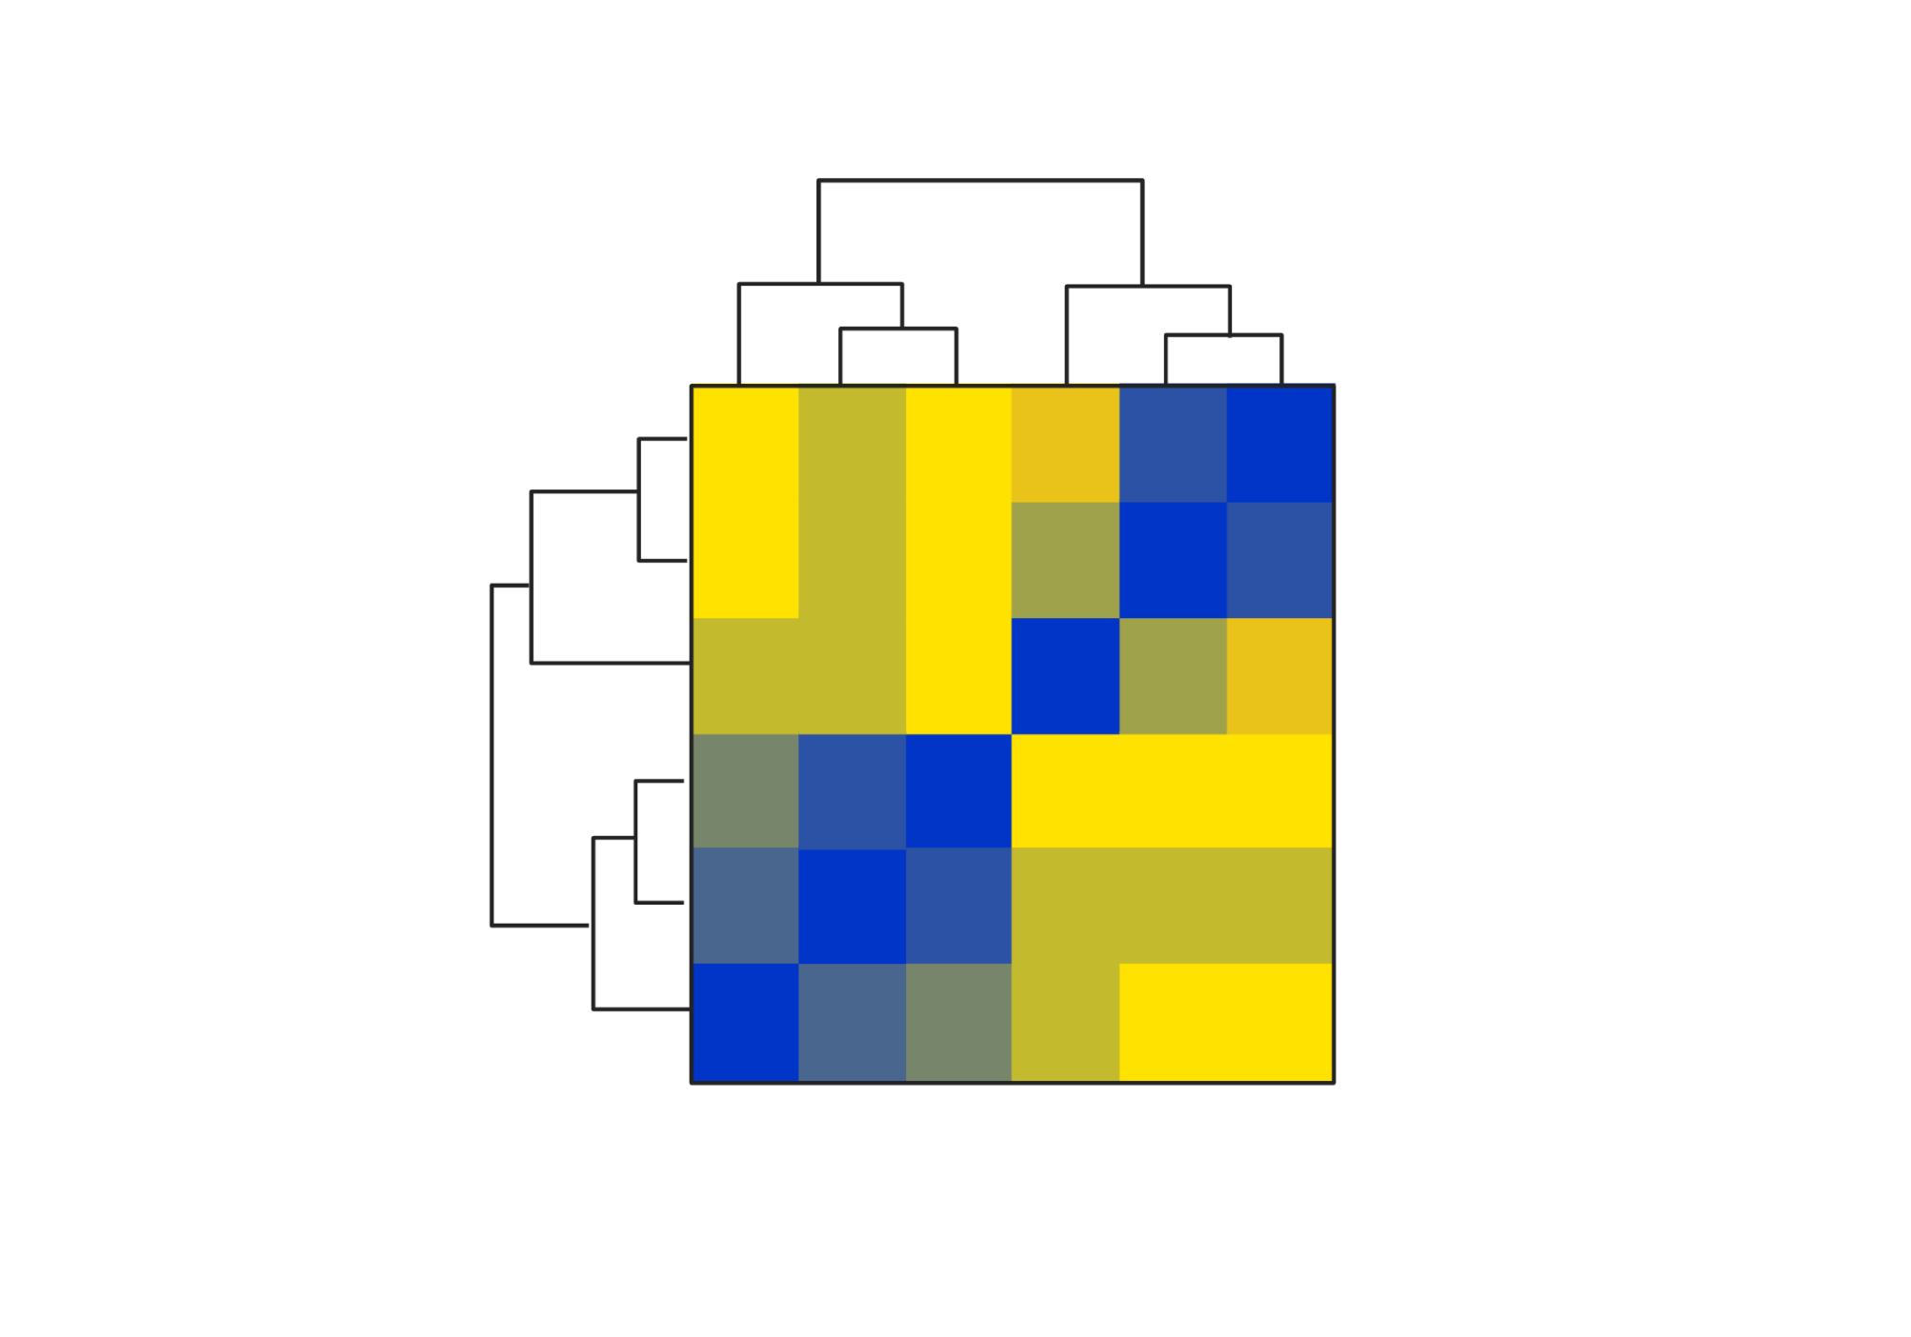
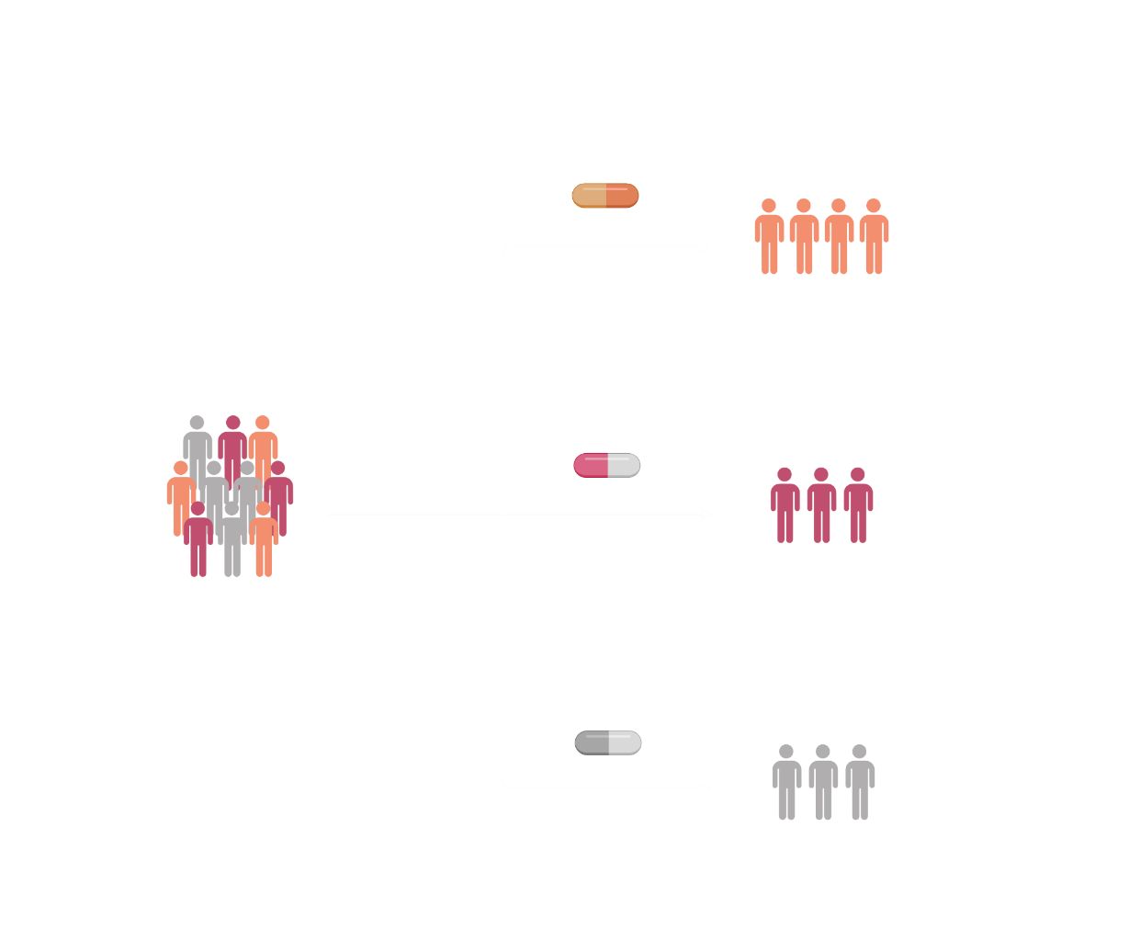
Final remarks
The traditional COO by IHC (GCB vs non-GCB) is not sufficient to predict prognosis or to plan therapy
GEP: gold standard
No available in clinical practice
Molecular classification vs Optimal Therapy
Design clinical trials and evolution of therapy
+
GCB
Non-GCB
+
CD10
MUM1
-
+
BCL6
-
-
GCB
Non-GCB

Slide 14

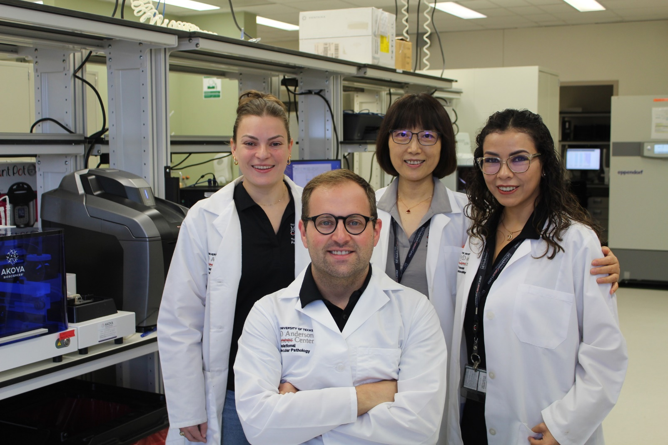
Acknowledgments
MDACC Heme malignancies Lab (TMP)
Ignacio I. Wistuba, MD
Daniela Duenas, MD
Mei Jiang
Salome A. McAllen, BS
MDACC Hematopathology
Roberto Miranda, MD
Francisco Vega, MD, PhD
L. Jeffrey Medeiros, MD
MDACC Hematopoietic Bio & Malig Clin
Pavan Bachireddy, MD, PhD
MDACC TMP-IL and TMP-DL
Carlos A. Torres-Cabala, MD
Cara Haymaker, PhD
Edwin R. Parra, MD, PhD
Luisa M. Solis, MD
Beatriz Sanchez-Espiridion, PhD
Jianling Zhou
Saxon Rodriguez
Auriole Tamegnon
Heladio Ibarguen
MDACC Lymphoma and Myeloma
Christopher R. Flowers, MD
Luis Malpica, MD
Paolo Strati, MD
Michael Green, PhD
Raphael Steiner, MD
Swaminathan Iyer, MD
MLPiubelli@mdanderson.org

Slide 15

Thank you! Gracias! Yusulpayki! Obrigado!
Fernando de Noronha, PE-Brazil, July/2023

